Slide 1

REAL-TIME IOT SECURITY MONITORING AND THREAT INTELLIGENCE SYSTEM
PRESENTED BY: ASHWANY C S PRK25DS1001

Slide 2
ABSTRACT
Real-time IoT network threat detection
MQTT protocol for device data collection
Traffic classified as Normal, Anomaly, Suspicious, or DDoS
Interactive dashboard with live alerts and device health
Visual charts for easy network activity interpretation
Automated PDF and Excel reporting for audits and analysis

Slide 3
TOOLS USED
Python – Backend programming
Flask – Web framework for dashboard
Socket.IO – Real-time server-dashboard communication
Paho-MQTT – Connects to IoT devices via MQTT
Scapy – Network packet capture and analysis
Chart.js – Interactive charts and graphs

Slide 4
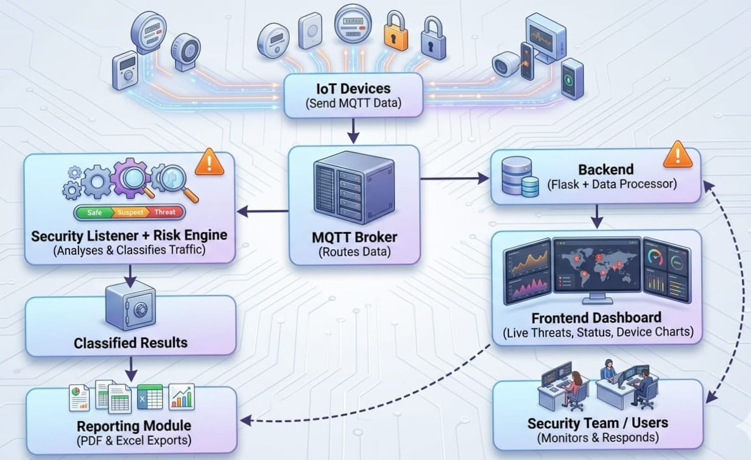
ARCHITECTURE OF THE PROPOSED SYSTEM

Slide 5
MODULES OF THE PROJECT
The system is divided into five main modules:
Web Dashboard: Live threat alerts, device counts, reports
MQTT Ingestion: Collects and structures IoT data
Threat Detection: Finds anomalies, assigns risk levels
Asset Tracker: Monitors device health & locations
Export & Compliance: Generates PDF/Excel audit reports

Slide 6
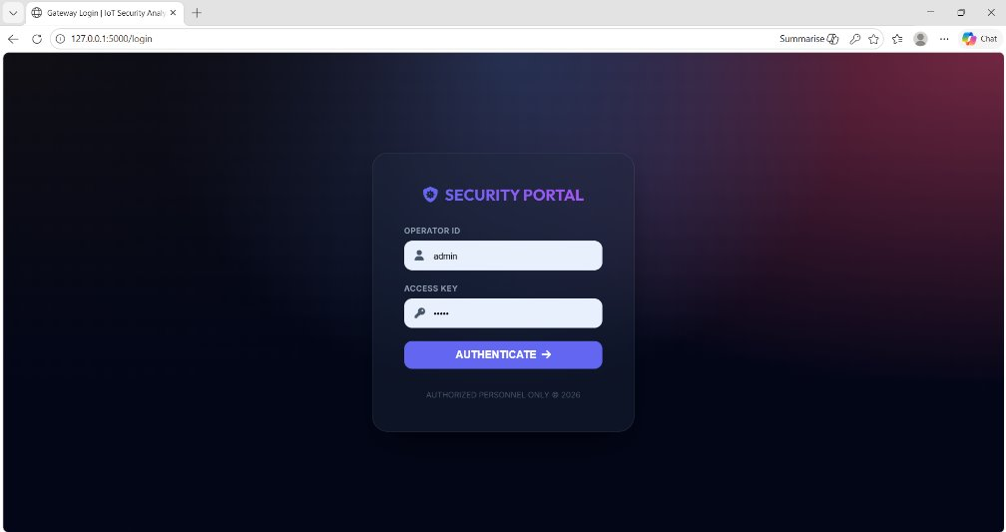
OUTPUT

Slide 7
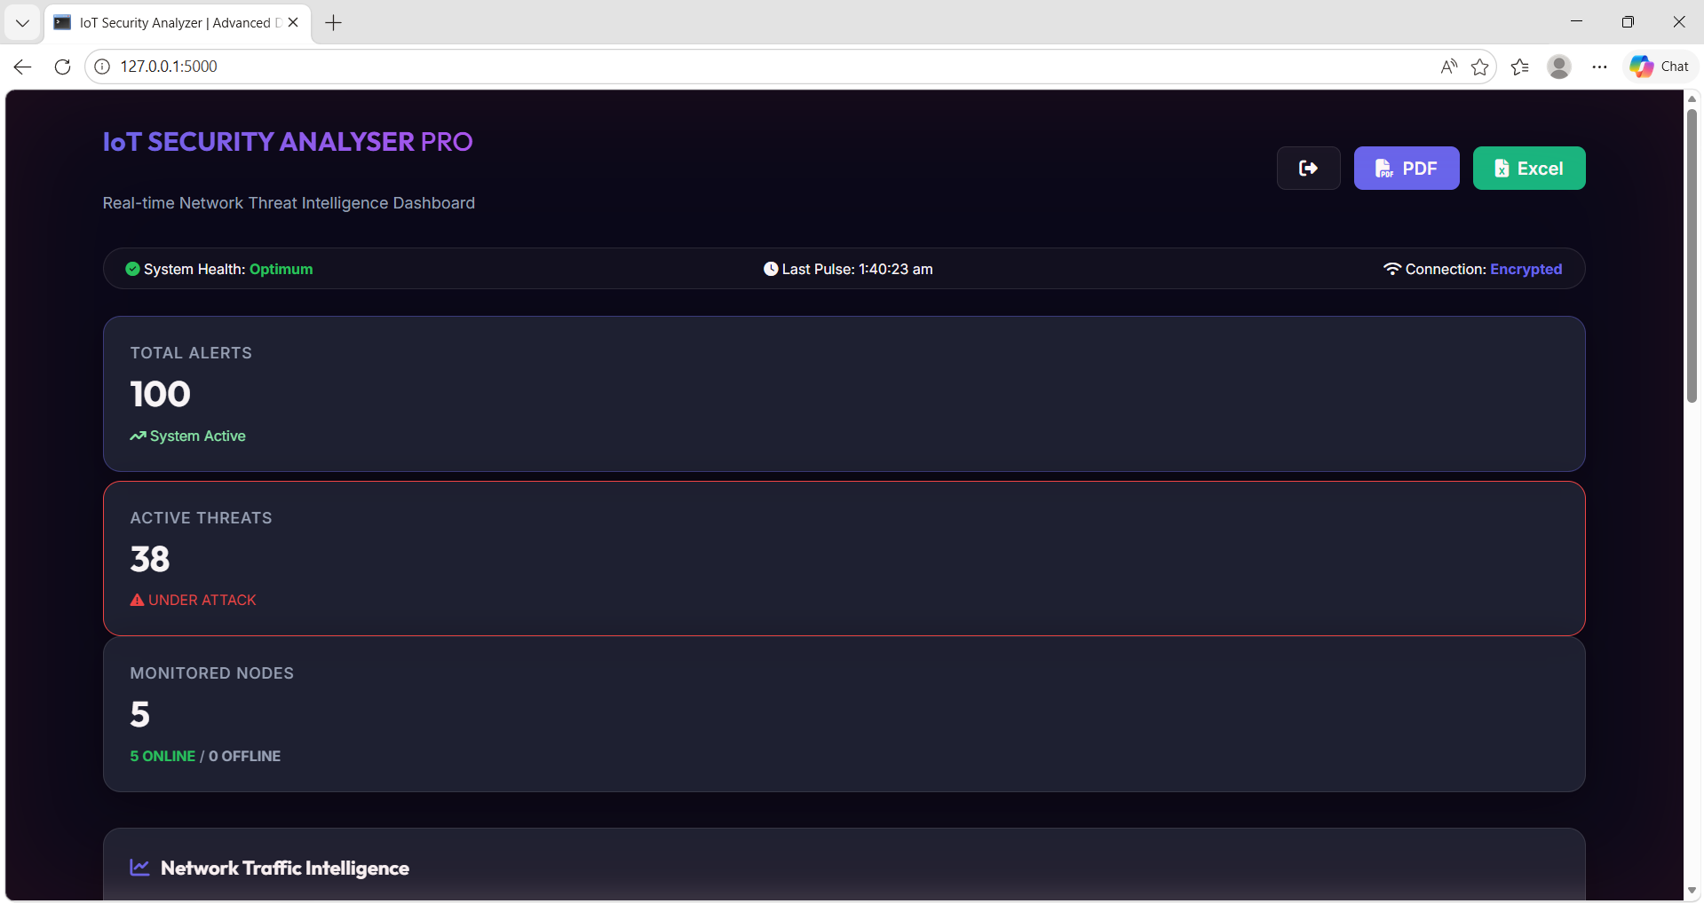

Slide 8
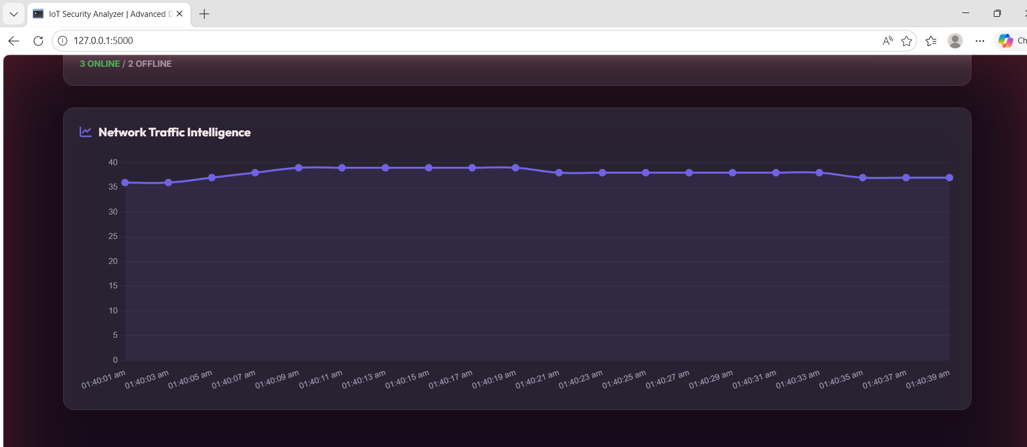

Slide 9
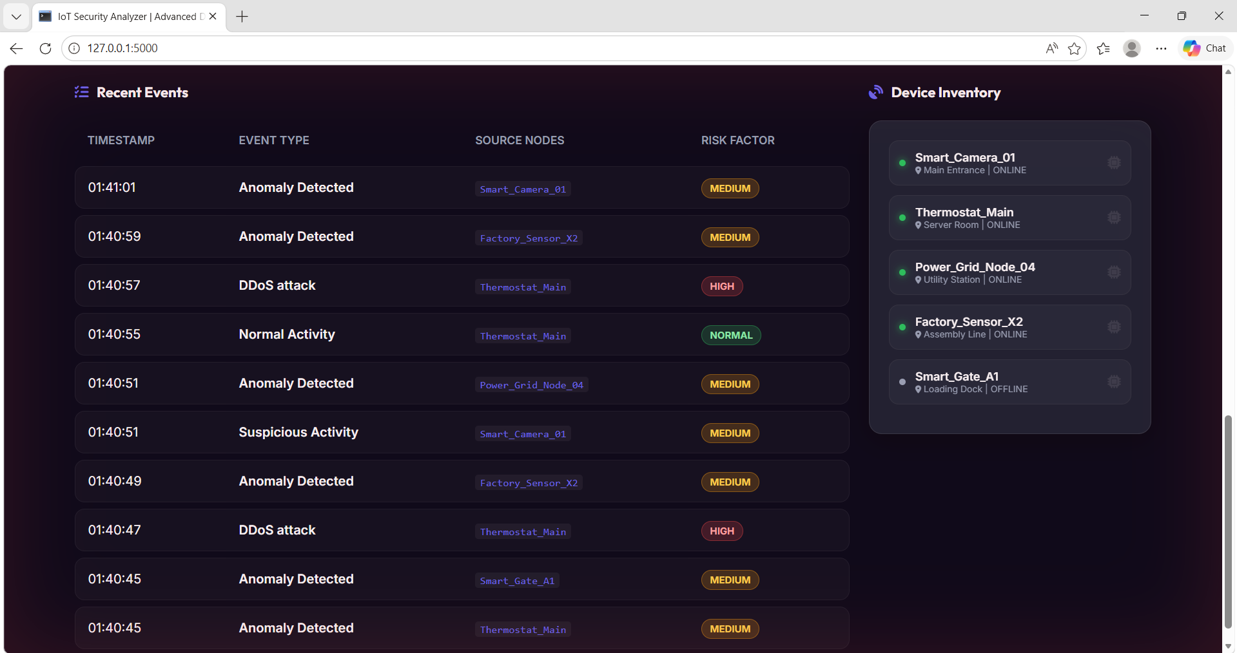

Slide 10
FUTURE RECOMMENDATIONS
Model Integration: AI/ML for predictive threat detection
Blockchain Verification: Decentralized device identity to prevent spoofing
Edge Computing: Risk analysis at gateways for faster response
Dynamic Firewalls: Auto-block offending IPs from Scapy alerts
Behavioral Profiling: Detect anomalies using traffic history

Slide 11
CONCLUSION
Detects real-time IoT network threats efficiently
Interactive dashboard simplifies monitoring
Automated PDF/Excel reports support audits
Provides structured insights for decision-making
Can be further enhanced with AI, blockchain, and edge computing

Slide 12
THANK YOU

